Slide 1

IBM BOB HACKATHON · SUPPLY CHAIN / LOGISTICS TRACK
LiveCold
Supply Chain Disruption Assistant & Fleet Utilisation Optimizer
Real-time disruption intelligence for resilient supply chains and protected cold-chain cargo
24 Active Shipments
7 At Risk
3 Cold-Chain Alerts
Team LiveCold · Live Demo: https://frontend-theta-sandy-vt0dijop0s.vercel.app/

Slide 2
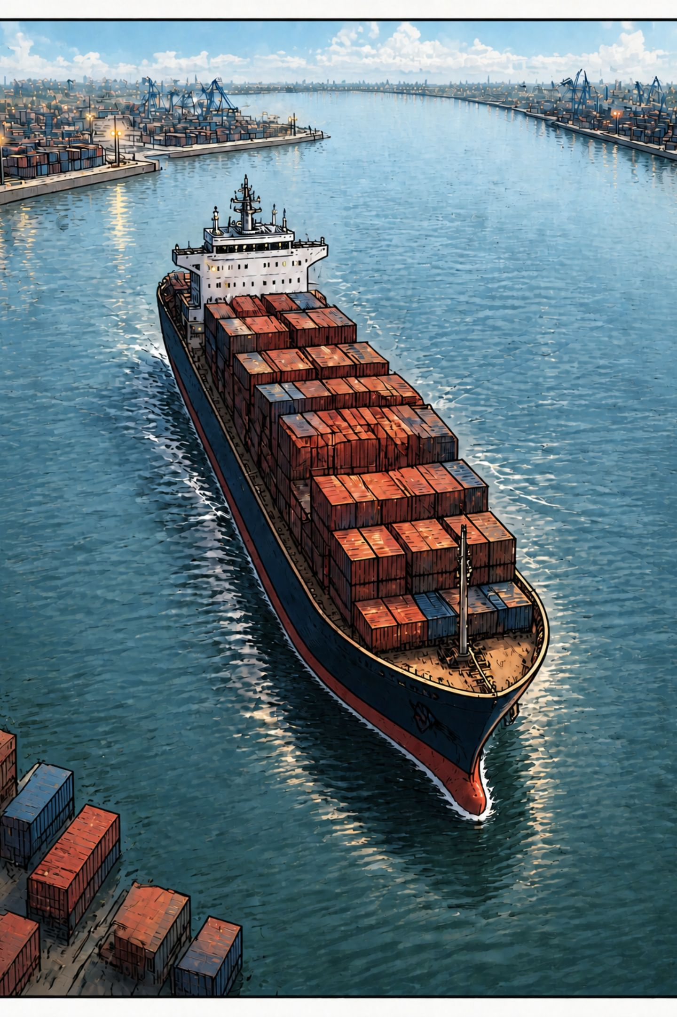

Supply-chain disruptions don't stay local.
01 — Disruption Cascade
02 — Fleet Imbalance
Weather, strikes and geopolitical issues can hit many shipments at once.
Some assets sit idle while other lanes become overloaded.
03 — Cold-Chain Blind Spots
Temperature issues often appear too late to fix.
The challenge is turning one event into fast, network-wide action.

Slide 3
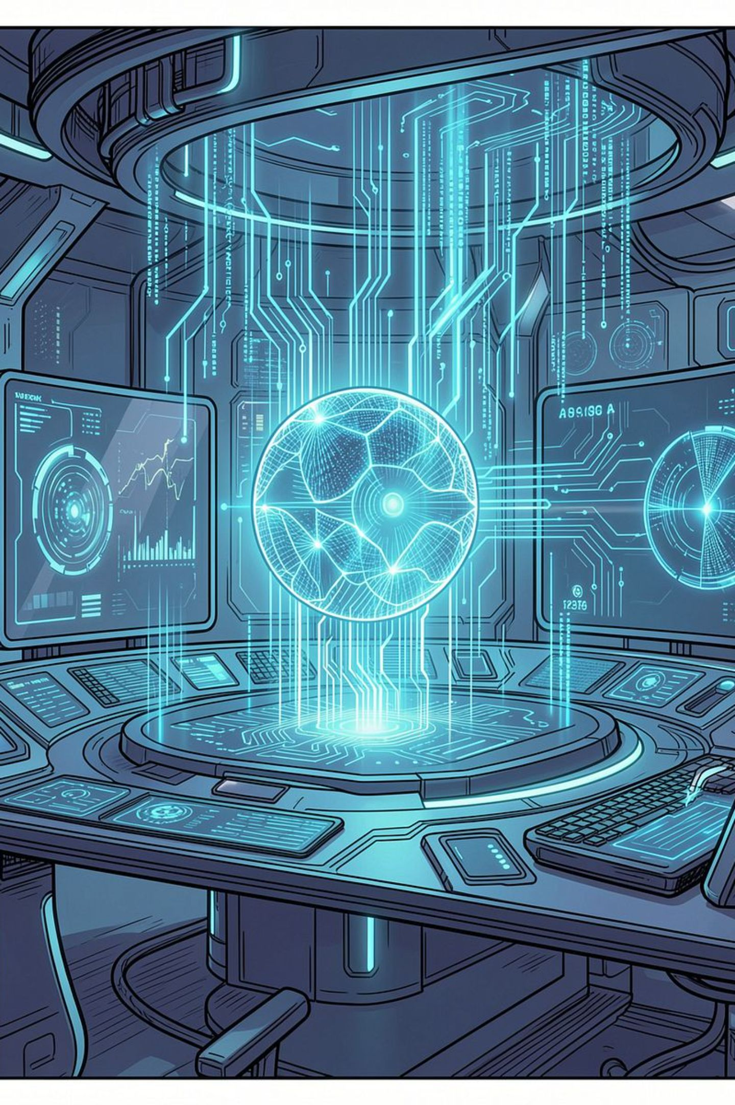




LiveCold turns live signals into operational decisions.
Ingest
Disruption events · Shipment status · Route info · Fleet availability · MQTT IoT telemetry
Detect
Affected shipments · Route disruptions · Temperature excursions · Fleet gaps · Risk severity
Intelligence
Streaming analytics · AI decision engine · Pathway RAG · Regulatory and SOP context
Act
Reroute · Alternative carriers · Fleet redeployment · Cold-chain intervention · Prioritization
Observe → Understand → Recommend → Act

Slide 4
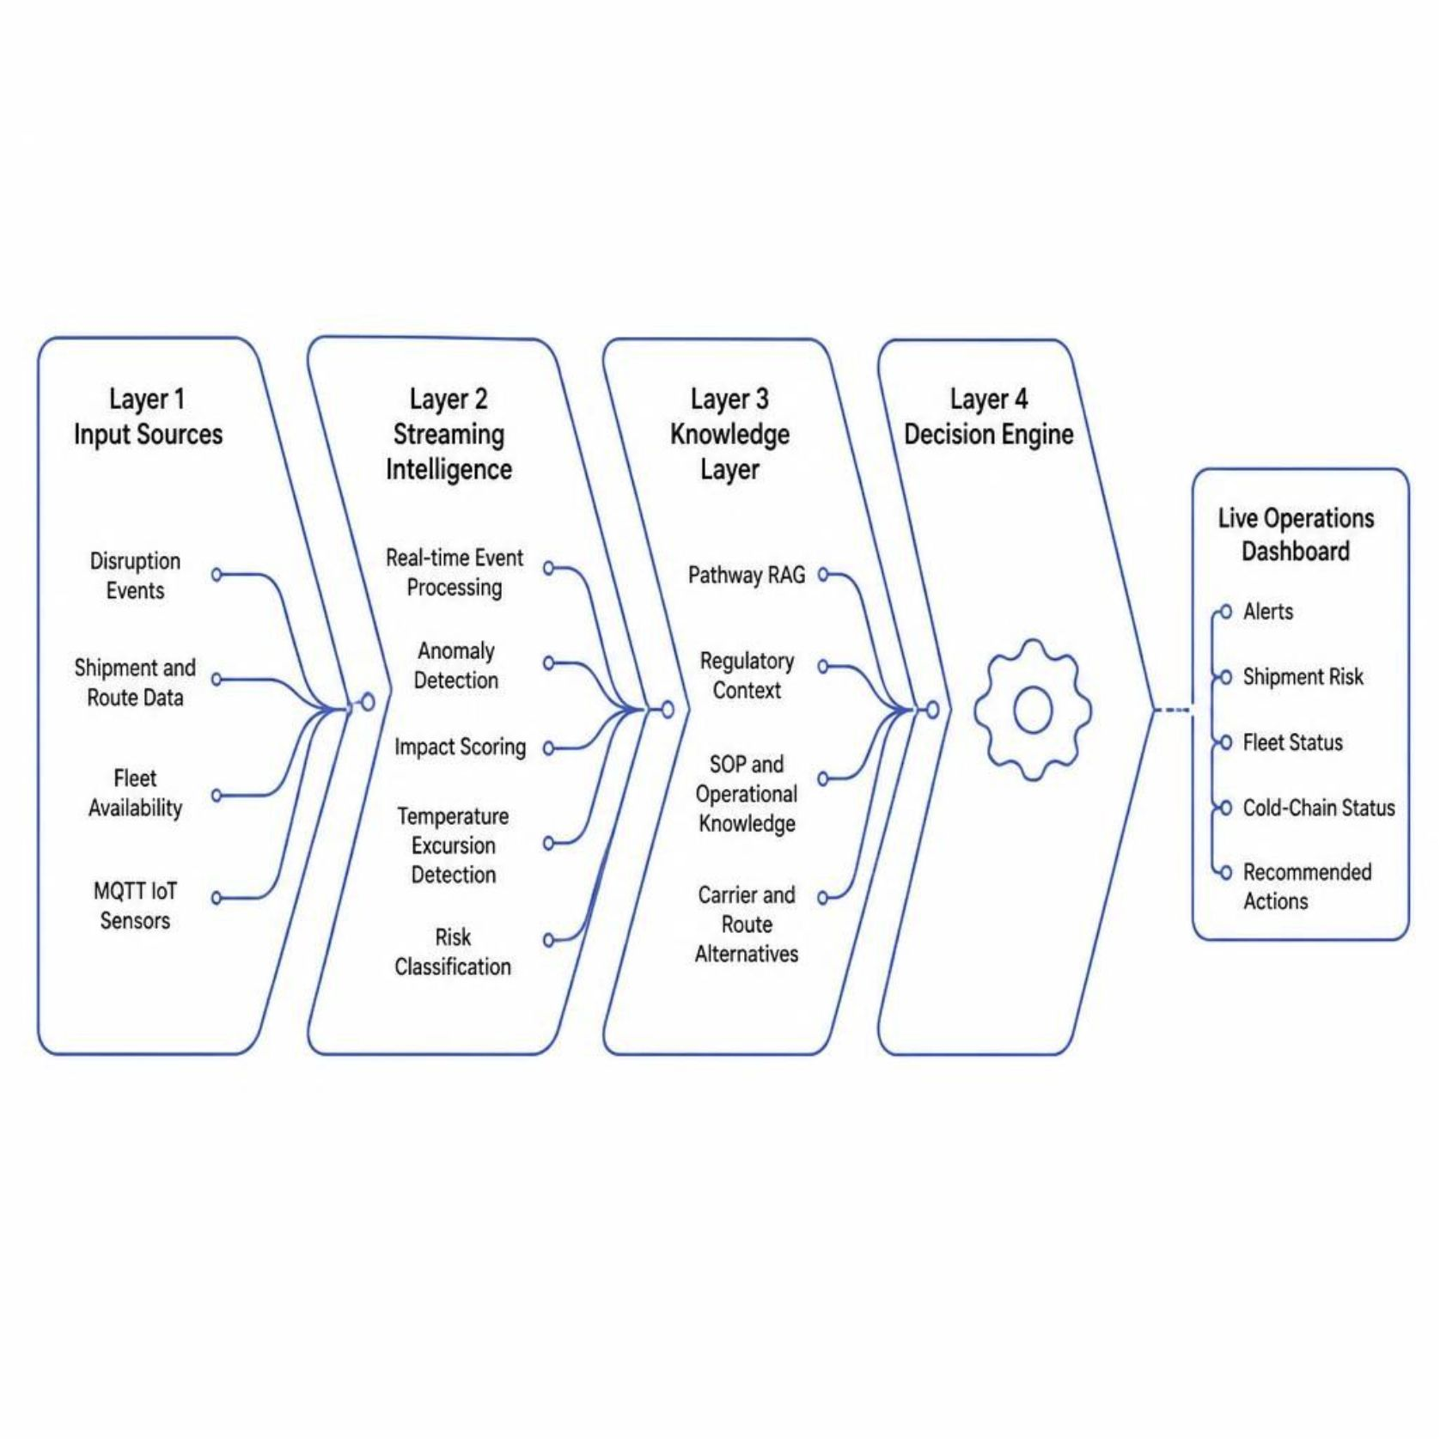
Real-time event → intelligence → action architecture
Architecture Principle
Live signals + context → actionable decisions
Affected shipments
Route changes
Carrier selection
Fleet redeployment
Temperature risk

Slide 5
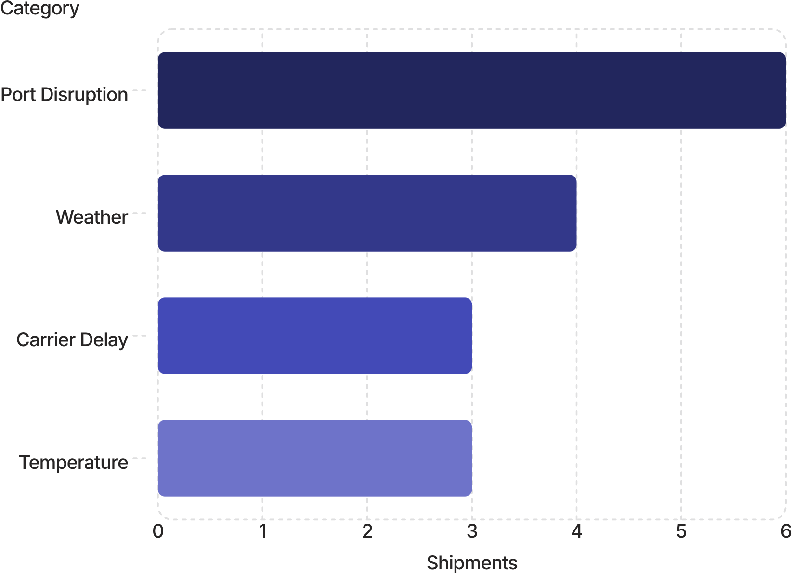
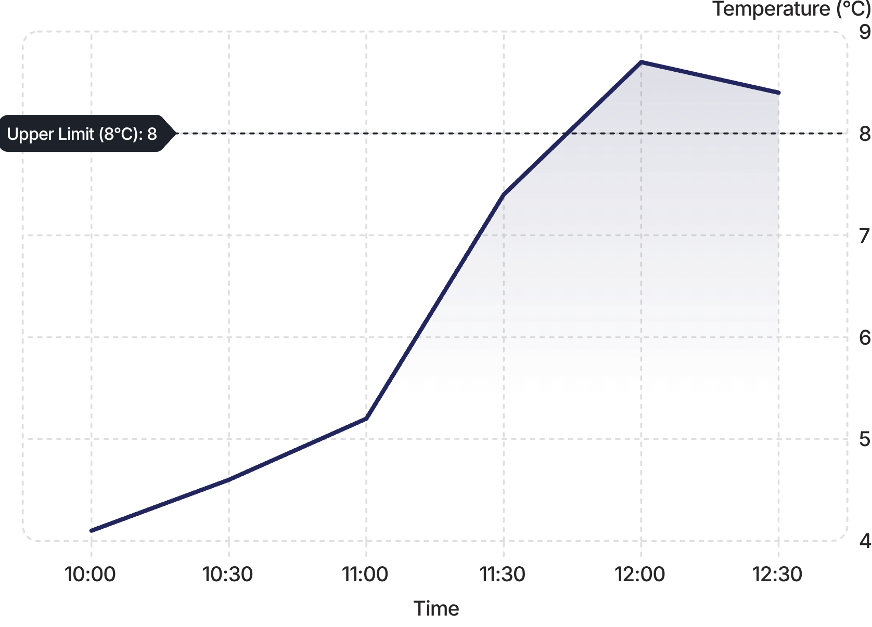
One operational view. Every critical exception prioritized.
24
07
Active Shipments
At Risk
03
11
Cold-Chain Alerts
Idle Assets
Shipment Risk by Category
Cold-Chain Temperature — SHP-1088
Illustrative demo data
Illustrative demo data · Safe band: 2–8°C

Slide 6





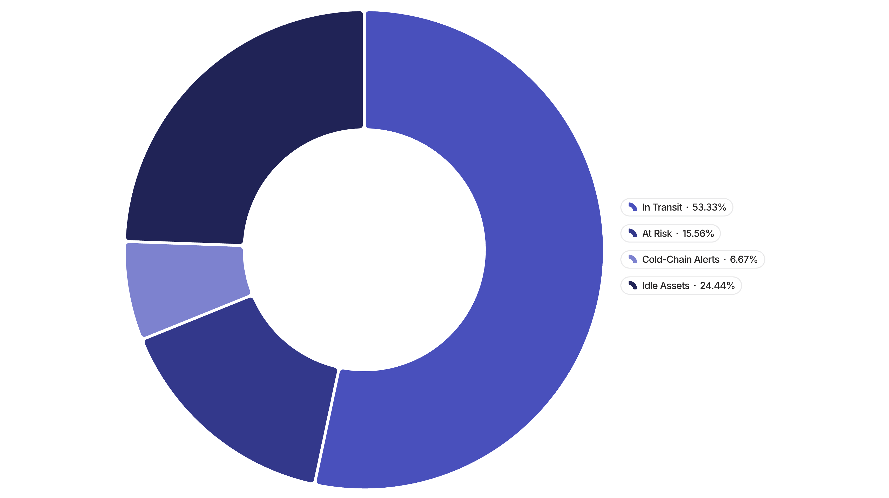
Detect the excursion before delivery.
Sensor
Detect
Classify
MQTT telemetry
Crosses threshold
Deviation · duration · severity
Contextualize
Recommend
Retrieves SOPs and handling rules
Inspect → isolate → divert
🚨 SHP-1088 · CRITICAL EXCURSION
8.7°C — above the safe band.
Fleet Status
Network Lane Recommendations
Prioritize rerouting the highest-risk lanes first, then rebalance capacity where the network
can absorb delays with the least disruption.
Shift sensitive freight away from disruption-prone lanes
Divert flagged shipments to the nearest compliant facility
Use idle assets to absorb overflow from constrained routes

Slide 7




Why this technology stack fits the problem
IBM Bob
MQTT
Speeds up engineering and integration.
Streams cold-chain sensor telemetry.
Pathway RAG
Streaming AI Engine
Grounds decisions in live knowledge.
Turns live events into actions.
Measure performance with live deployment telemetry during validation.

Slide 8

Built for real-world supply-chain operations.
Product / Team Lead
[Krish Sankhavara]
Problem framing · UX · Integration
AI / Data
Hit Barvaliya
Streaming intelligence · RAG · Risk scoring
Full Stack
Raj Bhut
Dashboard · APIs · Deployment
IoT / Domain
Bhavik Rabadiya
MQTT · Telemetry · Cold-chain rules
🚀 Live Demo
https://frontend-theta-sandy-vt0dijop0s.vercel.app/

